Slide 1

Results – Method 3
Experimental investigation of temperatures and heat flows for orthogonal cutting 1045 steel by thermal imaging

Slide 2
Gliederung
1
Experimental Setup
2
Post processing of thermal pictures
3
Orthogonal cutting of AISI 1040 (C45 E+N) normalized

Slide 3
Gliederung
1
Experimental Setup
2
Post processing of thermal pictures
3
Orthogonal cutting of AISI 1040 (C45 E+N) normalized

Slide 4
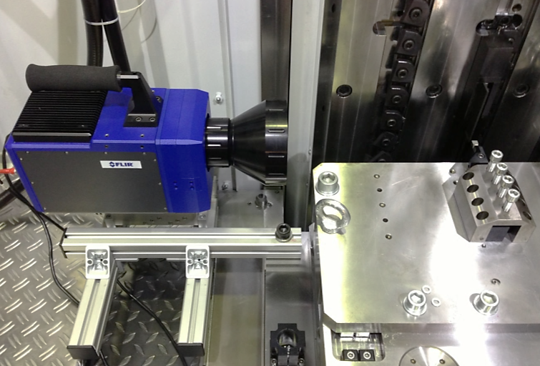
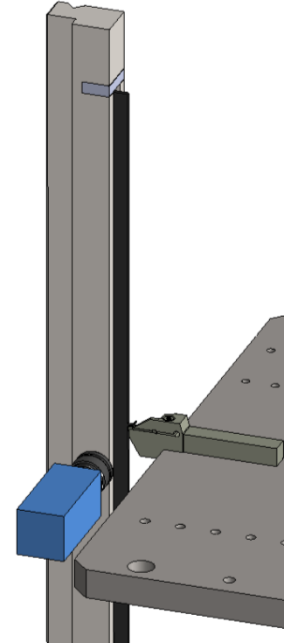
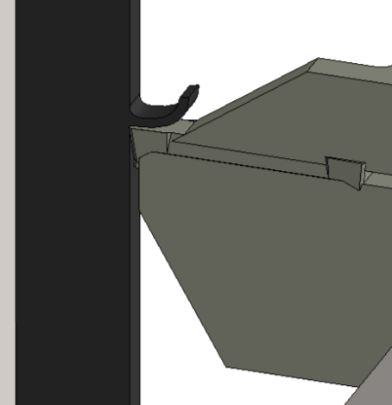
Experimental Setup Design of Experiment
Workpiece
Cutting process
Tool
Thermal camera
Area covered by the thermal camera

Slide 5
Experimental Setup Design of Experiment for AISI 1045
Experiments | Cutting Velocity [m/min] | Uncut chip thickness [µm] | Integration time [µs] | Cutting Force [N] | Passive Force [N] | Heat treatment | Contact length [mm]
VP41_1_H200_V100_C45_MF_425 | 100 | 200 | 425 | 1500 | 1000 | Normalized | 1,54
VP41_2_H200_V100_C45_MF_425 | 100 | 200 | 425 | 1565 | 1005 | Normalized | 1,59
VP42_1_H300_V100_C45_MF_425 | 100 | 300 | 425 | 2250 | 1159 | Normalized | 1,84
VP42_2_H300_V100_C45_MF_285 | 100 | 300 | 285 | 2136 | 1079 | Normalized | 1,9
VP43_1_H400_V100_C45_MF_285 | 100 | 400 | 285 | 2716 | 1118 | Normalized | 2,06
VP45_2_H200_V150_C45_MF_425 | 150 | 200 | 425 | 1448 | 688 | Normalized | 1,72
VP46_1_H300_V150_C45_MF_285 | 150 | 300 | 285 | 2006 | 801 | Normalized | 2,05
VP46_2_H300_V150_C45_MF_285 | 150 | 300 | 285 | 2004 | 875 | Normalized | 2,09
VP49_1_H400_V150_C45_MF_285 | 150 | 400 | 285 | 2675 | 1046 | Normalized | 2,27
VP49_2_H400_V150_C45_MF_285 | 150 | 400 | 285 | 2590 | 1000 | Normalized | 2,32
VP50_1_H500_V150_C45_MF_285 | 150 | 500 | 285 | 3220 | 1120 | Normalized | 2,51
VP50_2_H500_V150_C45_MF_285 | 150 | 500 | 285 | 3178 | 1162 | Normalized | 2,41

Slide 6
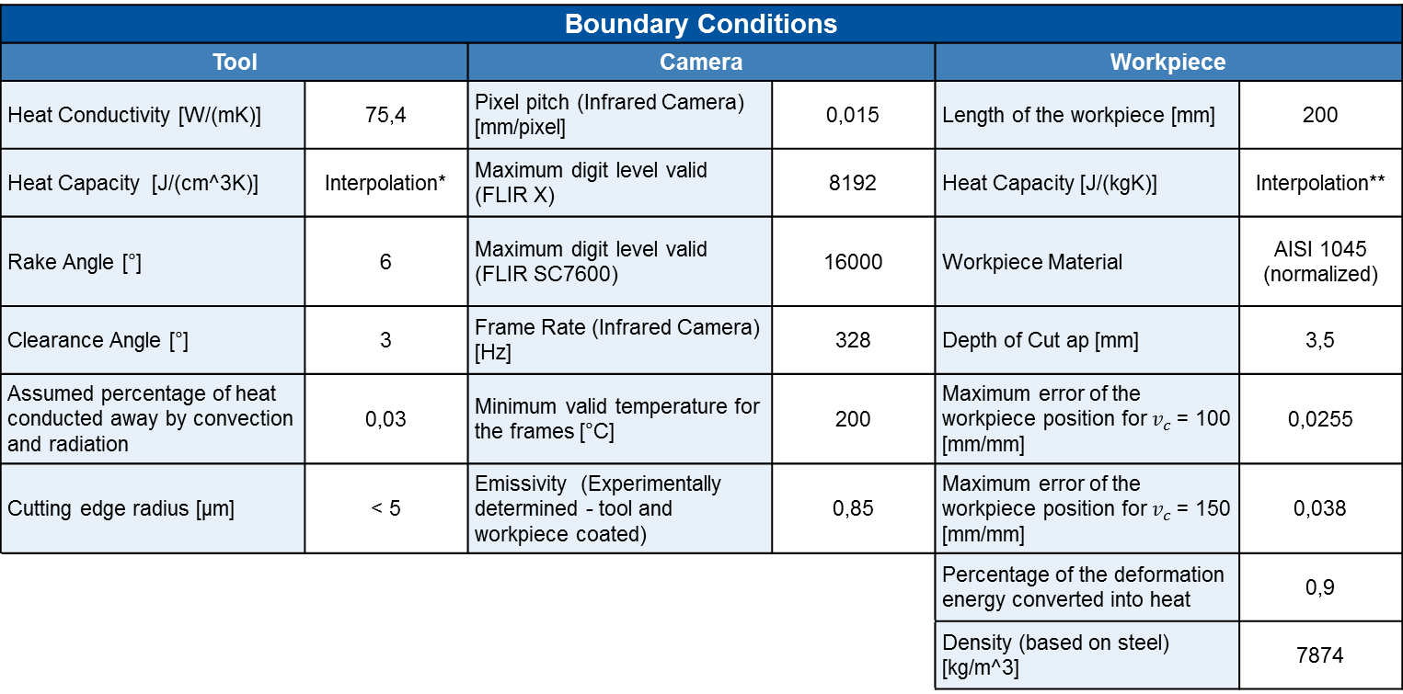
Experimental Setup Boundary Conditions for AISI 1045
Boundary Conditions
Tool |  | Camera |  | Workpiece
Heat Conductivity [W/(mK)] | 75,4 | Pixel pitch (Infrared Camera) [mm/pixel] | 0,015 | Length of the workpiece [mm] | 200
Heat Capacity [J/(cm^3K)] | Interpolation* | Maximum digit level valid (FLIR X) | 8192 | Heat Capacity [J/(kgK)] | Interpolation**
Rake Angle [°] | 6 | Maximum digit level valid (FLIR SC7600) | 16000 | Workpiece Material | AISI 1045 (normalized)
Clearance Angle [°] | 3 | Frame Rate (Infrared Camera) [Hz] | 328 | Depth of Cut ap [mm] | 3,5
Assumed percentage of heat conducted away by convection and radiation | 0,03 | Minimum valid temperature for the frames [°C] | 200 | Maximum error of the workpiece position for $v_{c}$ = 100 [mm/mm] | 0,0255
Cutting edge radius [µm] | < 5 | Emissivity (Experimentally determined - tool and workpiece coated) | 0,85 | Maximum error of the workpiece position for $v_{c}$ = 150 [mm/mm] | 0,038
 |  |  |  | Percentage of the deformation energy converted into heat | 0,9
 |  |  |  | Density (based on steel) [kg/m^3] | 7874
Interpolation
*Tool [J/(cm^3K)]
$$c_{p}\left(T\right)=2,51∗{10}^{−10}T^{3}−1,99∗{10}^{−6}T^{2}+0,0027T+3,09$$
**Workpiece [J/(kgK)]
$$c_{p}\left(T\right)=−4,39∗{10}^{−7}T^{3}−7,07∗{10}^{−4}T^{2}+0,0489T+481,21$$

Slide 7
Experimental Setup Heat capacity data
Tool Material |  |  | Workpiece Material
Temperature [°C] | Heat Capacity [J/(cm³K)] | Heat Conductivity [W/(mK)] | Temperature [°C] | Heat Capacity [J/(kgK)] | Heat Conductivity [W/(mK)] | Density [Kg/m³]
20 | 3,2 | 100 | 20 | 474,62 | 48,03 | 7820,9
100 | 3,24 | 94,8 | 100 | 487,94 | 47,21 | 7794,3
200 | 3,59 | 88,3 | 200 | 501,2 | 45,82 | 7764,2
300 | 3,79 | 81,9 | 300 | 521,29 | 42,74 | 7732
400 | 3,9 | 75,4 | 400 | 545,69 | 39,1 | 7697,4
500 | 3,97 | 68,9 | 500 | 572,7 | 35,35 | 7660,4
600 | 4,05 | 66,7 | 600 | 601,83 | 31,73 | 7620,9
700 | 4,14 | 64,8 | 700 | 632,89 | 28,33 | 7578,7
 |  |  | 800 | 696,29 | 23,52 | 7579,4
 |  |  | 900 | 693,79 | 25,25 | 7528,3
 |  |  | 1000 | 691,3 | 26,61 | 7475
 |  |  | 1100 | 688,81 | 27,9 | 7419,7
 |  |  | 1200 | 686,34 | 29,34 | 7362,3
*Data base for interpolation

Slide 8
Gliederung
1
Experimental Setup
2
Post processing of thermal pictures
3
Orthogonal cutting of AISI 1040 (C45 E+N) normalized

Slide 9
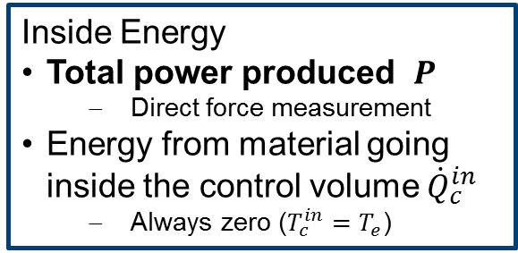
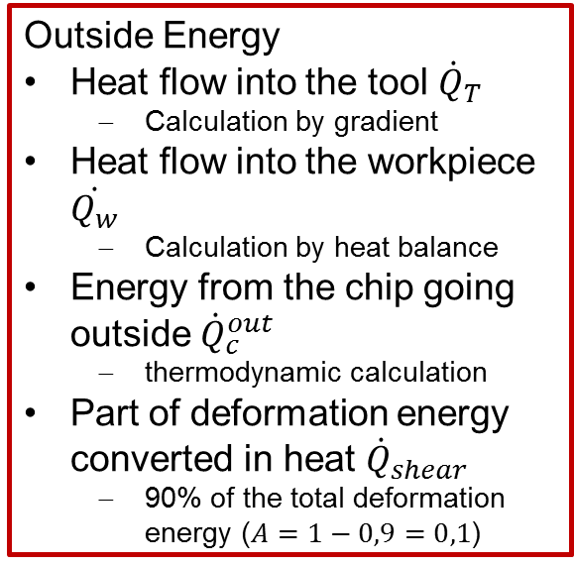
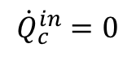
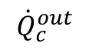
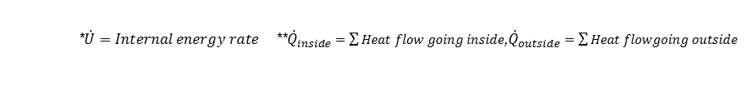
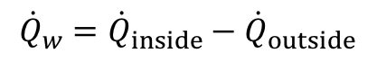
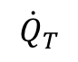
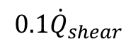
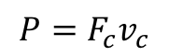
Post processing of thermal pictures Energy balance in the volume control
Inside Energy
Total power produced $P$
Direct force measurement
Energy from material going inside the control volume ${\dot{Q}}_{c}^{in}$
Always zero ($T_{c}^{in}=T_{e}$)
$${\dot{Q}}_{c}^{out}$$
End of contact
$${\dot{Q}}_{T}$$
$${0.1\dot{Q}}_{shear}$$
Outside Energy
Heat flow into the tool ${\dot{Q}}_{T}$
Calculation by gradient
Heat flow into the workpiece $\dot{Q_{w}}$
Calculation by heat balance
Energy from the chip going outside ${\dot{Q}}_{c}^{out}$
thermodynamic calculation
Part of deformation energy converted in heat ${\dot{Q}}_{shear}$
90% of the total deformation energy ($A=1−0,9=0,1$)
$$P=F_{c}v_{c}$$
Chip
Tool
$${\dot{Q}}_{c}^{in}=0$$
Workpiece
$${\dot{Q}}_{w}={\dot{Q}}_{inside}−{\dot{Q}}_{outside}$$
Control volume
*$\dot{U}=Internal energy rate$**${\dot{Q}}_{inside}=\sum{Heat flow going inside}$,${\dot{Q}}_{outside}=\sum{Heat flowgoing outside }$
Notes:
In this analysis, the energy flows considered for the volume control are listed above. Then, with the temperature field of the Infrared camera frames, this analysis is able to calculate the heat flow through the tool and the chip and, consequently, the heat partition of the total power produced during the process. About 90% of the deformation energy is converted in heat and the heat flow through the workpiece is calculated by the total balance.

Slide 10
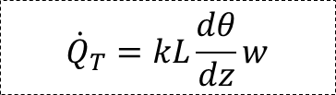
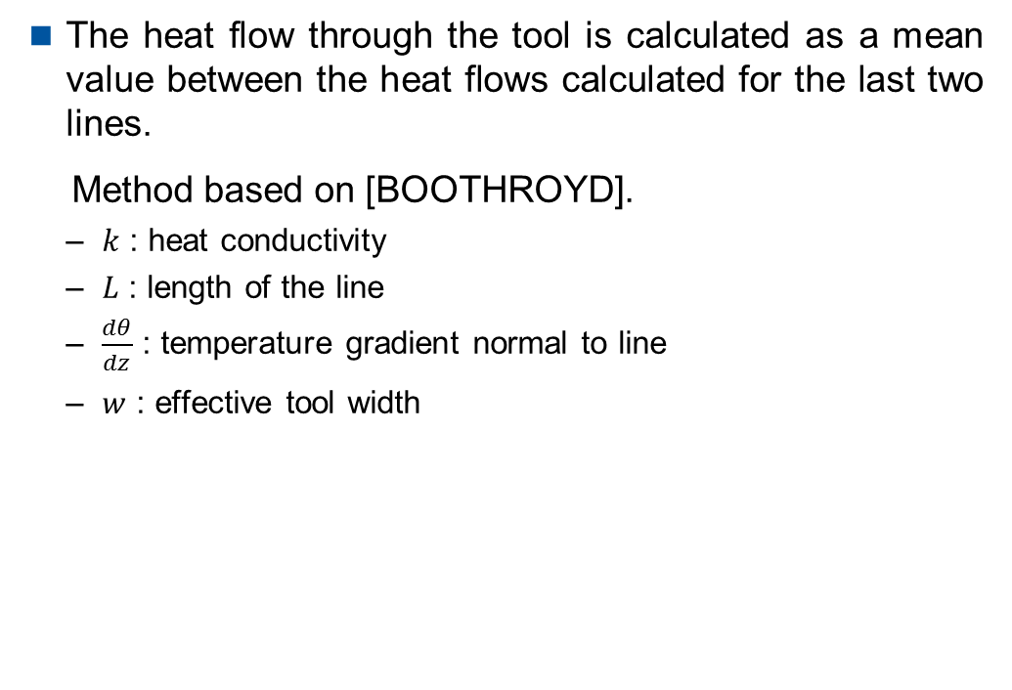
Post processing of thermal pictures Heat carried away from the tool tip
The heat flow through the tool is calculated as a mean value between the heat flows calculated for the last two isothermals.
Method based on [BOOTHROYD].
$k$ : heat conductivity
$L$ : length of the isothermal
$\frac{dθ}{dz}$ : temperature gradient normal to line
$w$ : effective tool width
Tool
$${\dot{Q}}_{T}$$
$${\dot{Q}}_{T}=kL\frac{dθ}{dz}w$$

Slide 11
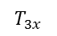
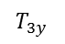
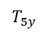
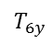
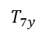
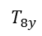
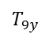
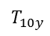
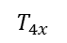
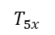
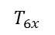
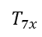
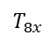
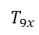
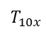
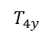
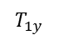
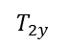
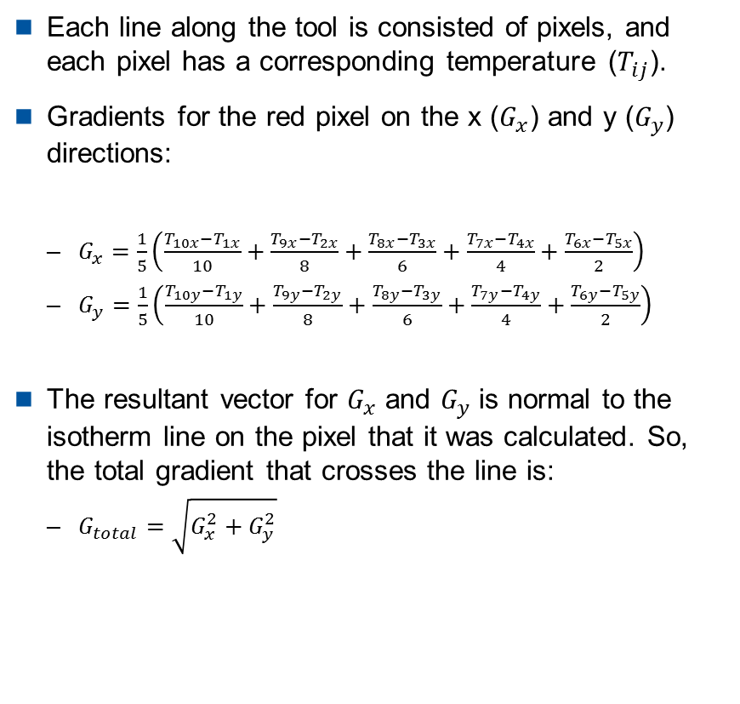
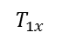
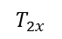
Post processing of thermal pictures Temperature gradient – calculation method
Each line along the tool is consisted of pixels, and each pixel has a corresponding temperature ($T_{ij}$).
Gradients for the red pixel on the x ($G_{x}$) and y ($G_{y}$) directions:
$G_{x}=\frac{1}{5}\left(\frac{T_{10x}−T_{1x}}{10}+\frac{T_{9x}−T_{2x}}{8}+\frac{T_{8x}−T_{3x}}{6}+\frac{T_{7x}−T_{4x}}{4}+\frac{T_{6x}−T_{5x}}{2}\right)$
$G_{y}=\frac{1}{5}\left(\frac{T_{10y}−T_{1y}}{10}+\frac{T_{9y}−T_{2y}}{8}+\frac{T_{8y}−T_{3y}}{6}+\frac{T_{7y}−T_{4y}}{4}+\frac{T_{6y}−T_{5y}}{2}\right)$
The resultant vector for $G_{x}$ and $G_{y}$ is normal to the isotherm line on the pixel that it was calculated. So, the total gradient that crosses the line is:
$G_{total}=\sqrt{G_{x}^{2}+G_{y}^{2}}$
Tool
$$T_{1y}$$
Isothermal line
$$T_{2y}$$
$$T_{3y}$$
$$T_{4y}$$
$$T_{5y}$$
$$T_{1x}$$
$$T_{2x}$$
$$T_{3x}$$
$$T_{4x}$$
$$T_{5x}$$
$$T_{6x}$$
$$T_{7x}$$
$$T_{8x}$$
$$T_{9x}$$
$$T_{10x}$$
$$T_{6y}$$
$$T_{7y}$$
$$T_{8y}$$
$$T_{9y}$$
$$T_{10y}$$

Slide 12
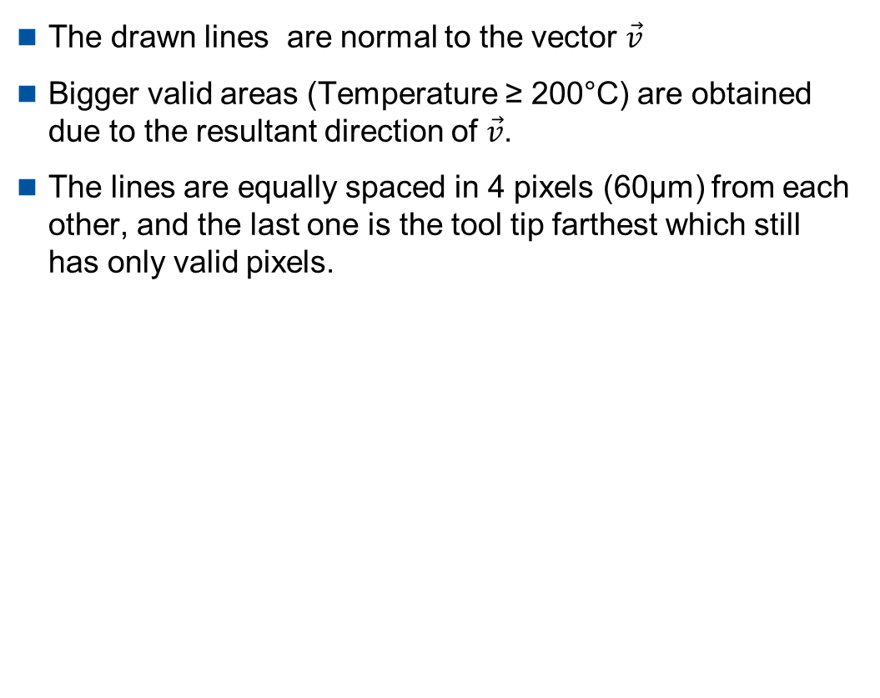
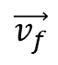
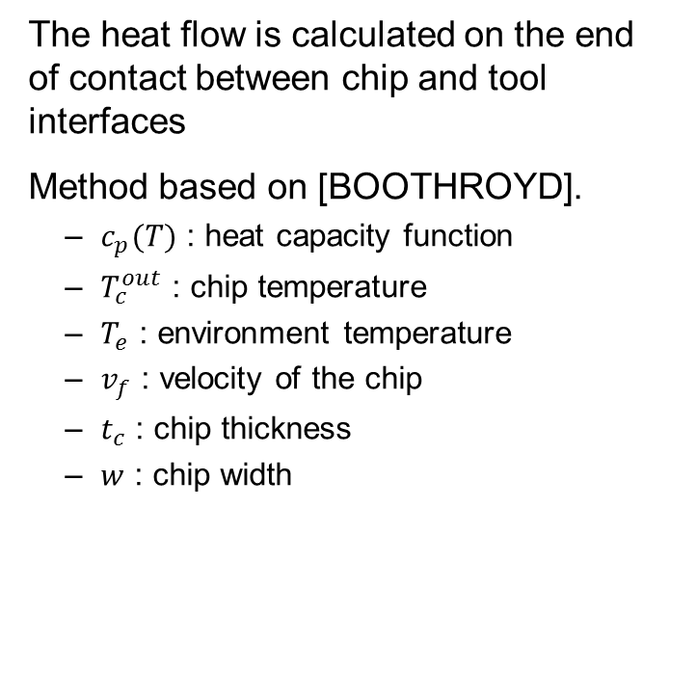
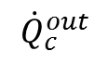
Post processing of thermal pictures Heat carried away by the chip
The heat flow is calculated on the end of contact between chip and tool interfaces
Method based on [BOOTHROYD].
$c_{p}(T)$ : heat capacity function
$T_{c}^{out}$ : chip temperature
$T_{e}$ : environment temperature
$v_{f}$ : velocity of the chip
$t_{c}$ : chip thickness
$w$ : chip width
$${\dot{Q}}_{c}^{out}$$
End of contact chip - tool
$$\vec{v_{f}}$$
Chip
Tool
$${\dot{Q}}_{c}^{out}=c_{p}\left(T_{c}^{out}−T_{e}\right)v_{f}t_{c}w$$

Slide 13
Gliederung
1
Experimental Setup
2
Post processing of thermal pictures
3
Orthogonal cutting of AISI 1040 (C45 E+N) normalized
3.1
Time and spatial varying thermal properties
3.2
Influence of uncut chip thickness and cutting velocity

Slide 14
Time and spatial varying thermal properties Temperature at tool tip [°C] for different v_{c} and h_{sp}

Slide 15
Time and spatial varying thermal properties Internal energy in tool [Joule] for different v_{c} and h_{sp}
Notes:
The higher the chip thickness the higher the internal energy/heat rate
The lower the cutting speed the higher the internal energy in the tool → High Speed cutting

Slide 16
Time and spatial varying thermal properties Internal energy rate of the tool [W] for different v_{c} and h_{sp}
Notes:
Heating rate rises with chip thickness
Heating rate decreases with cutting speed
H/v → Heating rate
1,33
2
4
2
3
2,66
3,333

Slide 17
Time and spatial varying thermal properties Total Power [W] for different v_{c} and h_{sp}

Slide 18
Time and spatial varying thermal properties Internal energy carried away by chip [W] for different v_{c} and h_{sp}
Notes:
Heat carried away by chip rises with hsp*vc
Heat carried away by chip increases with cutting length for small chip thickness
Why?????
v_{c*} h_{sp} ~ ${\dot{ q}}^{´}$_{chip} ; l_{c} ↑ → ${\dot{ q}}^{´}$_{chip} = const. (gilt nicht für Vp41 , VP42)
${\dot{ q}}^{´}$_{chip} ↑ → B_{chip} ↑ (für Vp41 , VP42)

Slide 19
Time and spatial varying thermal properties Heat partition to the chip for different v_{c} and h_{sp}
Notes:
No influence of level of heat partition inside the chip by chip thickness
Rising heat partition inside the chip, especially for lower chip thickness → Hypo: tool is heating up and is conducts less heat away
Hypo: The lower the chip thickness the lower the influence of friction at the rake face
1 = B_{chip} + B_{tool} + B_{WP}
B_{tool} = konst. ; B_{chip} ↑ → B_{WP} ↓

Slide 20
Time and spatial varying thermal properties Heat flow into the tool [W] for different v_{c} and h_{sp}

Slide 21
Time and spatial varying thermal properties Heat flow into the tool [W] for different v_{c} and h_{sp} 2
Notes:
For small chip thickness no influence of cutting speed
Heat flux into the tool rises with chip thickness decreasingly,
Less rise for smaller cutting speeds
Decreases for higher chip thickness over time constant for small chip thickness hypo: tool gets to hot to carry heat away
Hypo: The higher the chip thickness the higher the frictional influence
Thermal number? Vc *hsp??

Slide 22
Time and spatial varying thermal properties Heat partition into the tool for different v_{c} and h_{sp}
Notes:
Heat partition inside tool higher for low cutting speed → Puls
No influence of chip thickness → Puls
Remains constant over time

Slide 23
Time and spatial varying thermal properties Heat flow into the workpiece [W] for different v_{c} and h_{sp}
Notes:
Heat flux inside work piece decreases with cutting speed and chip thickness
Heat flux into workpiece decreases over cutting length for small chip thickness
How over time?
How is this possible?

Slide 24
Time and spatial varying thermal properties Heat partition into the workpiece for different v_{c} and h_{sp}
Notes:
Heat partition into workpiece independent from vc and hsp does not fit to K&H
Decreases for small chip thickness

Slide 25
Time and spatial varying thermal properties Friction coefficient µ for different v_{c} and h_{sp}

Slide 26
Time and spatial varying thermal properties Heat partition ratios for h_{sp} = 200 µm, v_{c} = 100 m/min
VP41_2
Chip
Work piece
Tool

Slide 27
Temperature distribution for orthogonal cutting Temperature distribution for h_{sp} = 200 µm, v_{c} = 100 m/min
[°C]
[W]
Heat flow through the isothermal lines
[W]
Heat flow through the isothermal lines
Workpiece position : 124 mm
Workpiece position : 200 mm
[°C]
[°C]

Slide 28
Time and spatial varying thermal properties Heat partition ratios for h_{sp} = 200 µm, v_{c} = 150 m/min
VP45_2
Chip
Tool
Work piece

Slide 29
Time and spatial varying thermal properties Temperature distribution for h_{sp} = 200 µm, v_{c} = 150 m/min
[°C]
[W]
Heat flow through the isothermal lines
[W]
Heat flow through the isothermal lines
Workpiece position : 124 mm
Workpiece position : 200 mm
[°C]
[°C]
Notes:
With higher cutting speed and lower chip thickness more heat is transferred over tip

Slide 30
Time and spatial varying thermal properties Heat partition ratios for h_{sp} = 300 µm, v_{c} = 100 m/min
VP42_1
Chip
Work piece
Tool

Slide 31
Time and spatial varying thermal properties Temperature distribution for h_{sp} = 300 µm, v_{c} = 100 m/min
[°C]
[W]
Heat flow through the isothermal lines
[W]
Heat flow through the isothermal lines
Workpiece position : 124 mm
Workpiece position : 200 mm
[°C]
[°C]

Slide 32
Time and spatial varying thermal properties Heat partition ratios for h_{sp} = 300 µm, v_{c} = 150 m/min
VP46_1
Chip
Work piece
Tool

Slide 33
Time and spatial varying thermal properties Temperature distribution for h_{sp} = 300 µm, v_{c} = 150 m/min
[°C]
[W]
Heat flow through the isothermal lines
[W]
Heat flow through the isothermal lines
Workpiece position : 124 mm
Workpiece position : 200 mm
[°C]
[°C]

Slide 34
Time and spatial varying thermal properties Heat partition ratios for h_{sp} = 400 µm, v_{c} = 150 m/min
VP49_1
Chip
Work piece
Tool

Slide 35
Time and spatial varying thermal properties Temperature distribution for h_{sp} = 400 µm, v_{c} = 150 m/min [1/2]
[°C]
[W]
Heat flow through the isothermal lines
[W]
Heat flow through the isothermal lines
Workpiece position : 124 mm
Workpiece position : 200 mm
[°C]
[°C]

Slide 36
Time and spatial varying thermal properties Temperature distribution for h_{sp} = 400 µm, v_{c} = 150 m/min [2/2]
[°C]
[W]
Heat flow through the isothermal lines
[W]
Heat flow through the isothermal lines
Workpiece position : 124 mm
Workpiece position : 200 mm
[°C]
[°C]

Slide 37
Time and spatial varying thermal properties Heat partition ratios for h_{sp} = 500 µm, v_{c} = 150 m/min
VP50_1
Chip
Work piece
Tool

Slide 38
Time and spatial varying thermal properties Temperature distribution for h_{sp} = 500 µm, v_{c} = 150 m/min
[°C]
[W]
Heat flow through the isothermal lines
[W]
Heat flow through the isothermal lines
Workpiece position : 124 mm
Workpiece position : 200 mm
[°C]
[°C]

Slide 39
Time and spatial varying thermal properties Conclusion
XYZ

Slide 40
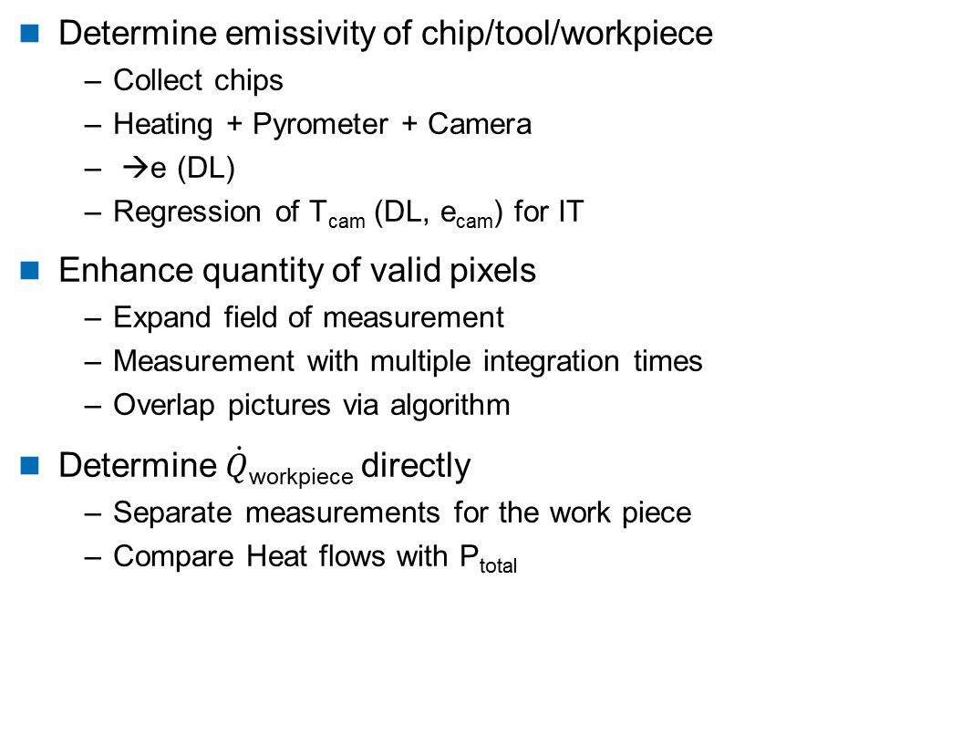
Time and spatial varying thermal properties Means to enhance quality of measurement
Determine emissivity of chip/tool/workpiece
Collect chips
Heating + Pyrometer + Camera
→e (DL)
Regression of T_{cam} (DL, e_{cam}) for IT
Enhance quantity of valid pixels
Expand field of measurement
Measurement with multiple integration times
Overlap pictures via algorithm
Determine $\dot{Q}$_{workpiece} directly
Separate measurements for the work piece
Compare Heat flows with P_{total}

Slide 41
Gliederung
1
Experimental Setup
2
Post processing of thermal pictures
3
Orthogonal cutting of AISI 1040 (C45 E+N) normalized
3.1
Time and spatial varying thermal properties
3.2
Influence of uncut chip thickness and cutting velocity

Slide 42
Influence of uncut chip thickness and cutting velocity Workpiece position 124 mm
a_{p} = 3,5 mm, $γ$ = 6°, $α$ = 3°, $r_{β}$ < 5 µm, uncoated, workpiece position: 124 mm
h_{sp} [µm]
Cutting velocity [m/min]

Slide 43
Influence of uncut chip thickness and cutting velocity Workpiece position 200 mm
a_{p} = 3,5 mm, $γ$ = 6°, $α$ = 3°, $r_{β}$ < 5 µm, uncoated, workpiece position: 200 mm
h_{sp} [µm]
Cutting velocity [m/min]

